Slide 1
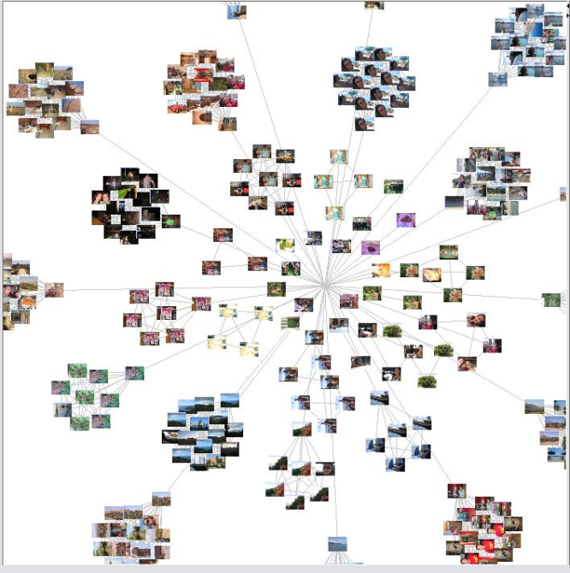
Fuzzy C-Means Clustering
Thực hiện:
Châu Vĩnh Tuân - 50802429
Phạm Nguyên Trình - 50802353

Slide 2
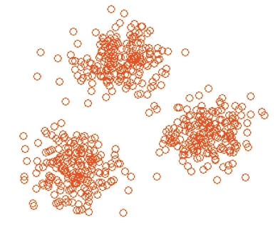
What is clustering?
Cluster analysis divides data into groups (clusters) that are meaningful, useful, or both. If meaningful groups are the goal, then the clusters should capture the natural structure of the data. In some cases, however, cluster analysis is only a useful starting point for other purposes, such as data summarization.
Cluster analysis groups data objects based only on information found in the data that describes the objects and their relationships. The goal is that the objects within a group be similar (or related) to one another and diﬀerent from (or unrelated to) the objects in other groups. The greater the similarity (or homogeneity) within a group and the greater the diﬀerence between groups, the better or more distinct the clustering.

Slide 3
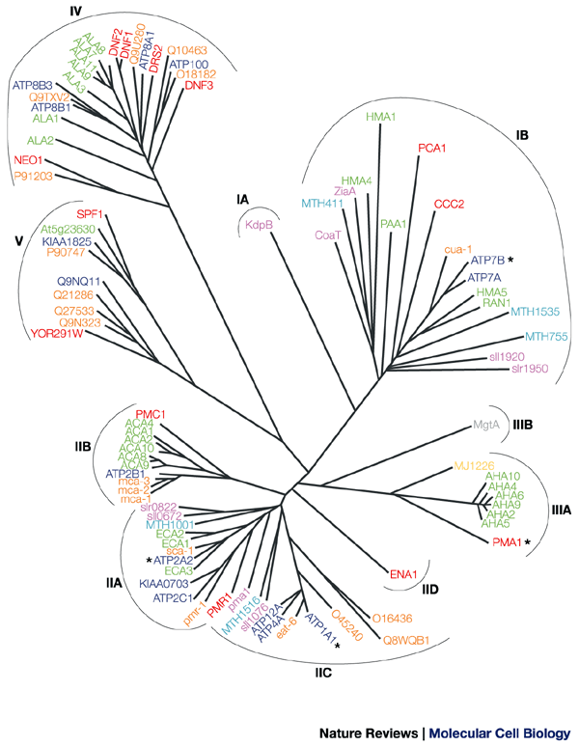
Where has clustering long played as an important role?
Clustering for Understanding
Biology.
Information Retrieval.
Climate
Psychology and Medicine.
Business
Clustering for Utility
Summarization
Compression
Eﬃciently Finding Nearest Neighbors

Slide 4
Diﬀerent Types of Clusterings
Hierarchical versus Partitional
Exclusive versus Overlapping versus Fuzzy
Complete versus Partial

Slide 5
Hierarchical versus Partitional
Traditional
Non- Traditional

Slide 6
Exclusive versus Overlapping versus Fuzzy
Exclusive versus Overlapping (non-Exclusive)
In non-exclusive clusterings, points may belong to multiple clusters.
Can represent multiple classes or ‘border’ points
Fuzzy
In fuzzy clustering, a point belongs to every cluster with some weight between 0 and 1
Weights must sum to 1
Probabilistic clustering has similar characteristics

Slide 7
Complete versus Partial
Complete
All data must be clustered
Partial
Just cluster some useful data

Slide 8
Diﬀerent Types of Clusters
Well-Separated
Prototype-Based
Graph-Based
Density-Based
Shared-Property (Conceptual Clusters)

Slide 9
Some important algorithms
We preview the following three simple, but important techniques to introduce many of the concepts involved in cluster analysis.
K-means. This is a prototype-based, partitional clustering technique that attempts to ﬁnd a user-speciﬁed number of clusters (K ), which are represented by their centroids.
Agglomerative Hierarchical Clustering. This clustering approach refers to a collection of closely related clustering techniques that produce a hierarchical clustering by starting with each point as a singleton cluster and then repeatedly merging the two closest clusters until a single, all-encompassing cluster remains. Some of these techniques have a natural interpretation in terms of graph-based clustering, while others have an interpretation in terms of a prototype-based approach.
DBSCAN. This is a density-based clustering algorithm that produces a partitional clustering, in which the number of clusters is automatically determined by the algorithm. Points in low-density regions are classi-ﬁed as noise and omitted; thus, DBSCAN does not produce a complete clustering.

Slide 10
Fuzzy Logic
Fuzzy Logic is a form of many-valued logic.
Fuzzy Logic variables may have a truth value that ranges in degree between [ 0, 1 ]

Slide 11
Fuzzy Set
Fuzzy sets are sets whose elements have degrees of membership.
A fuzzy set is a pair ( A , m ) where A is a set and m : A → [ 0 , 1 ]
For each x ∈ A , m(x) is called the grade of membership of x in (A,m). For a finite set A = {x₁,...,x_{n}}, the fuzzy set (A,m) is often denoted by{m(x₁) / x₁,...,m(x_{n}) / x_{n}}.
m(x) = 0 : x is not included in (A, m)
m(x) = 1: x is fully included in (A, m)

Slide 12
Fuzzy C-Means Clustering
Fuzzy c-means (FCM) is a method of clustering which allows one piece of data to belong to two or more clusters
Be frequently used in pattern recognition.

Slide 13
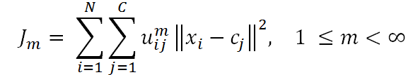
Fuzzy C-Means Clustering
Base on minimization of the following objective function:
m is any real number greater than 1
u_{ij} is the degree of membership of x_{i} in the cluster j
x_{i} is the i-th of d-dimensional measured data
c_{j} is the d-dimension center of the cluster
||*|| is any norm expressing the similarity between any measured data and the center

Slide 14

FCM algorithm
The algorithm is composed of the following steps
Initialize U=[u_{ij}] matrix, U⁽⁰⁾
At k-step: calculate the centers vectors C^{(k)}=[c_{j}] with U^{(k)}

Slide 15

FCM algorithm
The algorithm is composed of the following steps
Update U^{(k)} , U^{(k+1)}
If ||U^{(k+1)} - U^{(k)}||< ε (max_{ij} {|u_{ij}^{(k+1)}-u_{ij}^{(k)}|})
then STOP; otherwise return to step 2.

Slide 16
FCM advantages
Gives best result for overlapped data set and comparatively better then k-means algorithm.
Unlike k-means where data point must exclusively belong to one cluster center here data point is assigned membership to each cluster center as a result of which data point may belong to more then one cluster center.

Slide 17
FCM disadvantages
Apriori specification of the number of clusters.
With lower value of ε we get the better result but at the expense of more number of iteration.
Euclidean distance measures can unequally weight underlying factors.

Slide 18
FCM demo
http://home.dei.polimi.it/matteucc/Clustering/tutorial_html/AppletFCM.html

